Slide 1
Can You See That OK?
Tips and techniques for supporting users with low vision
Julie Grundy @stringy

Slide 2
Notes:
Who
Eye parts
Types of vision

Slide 3
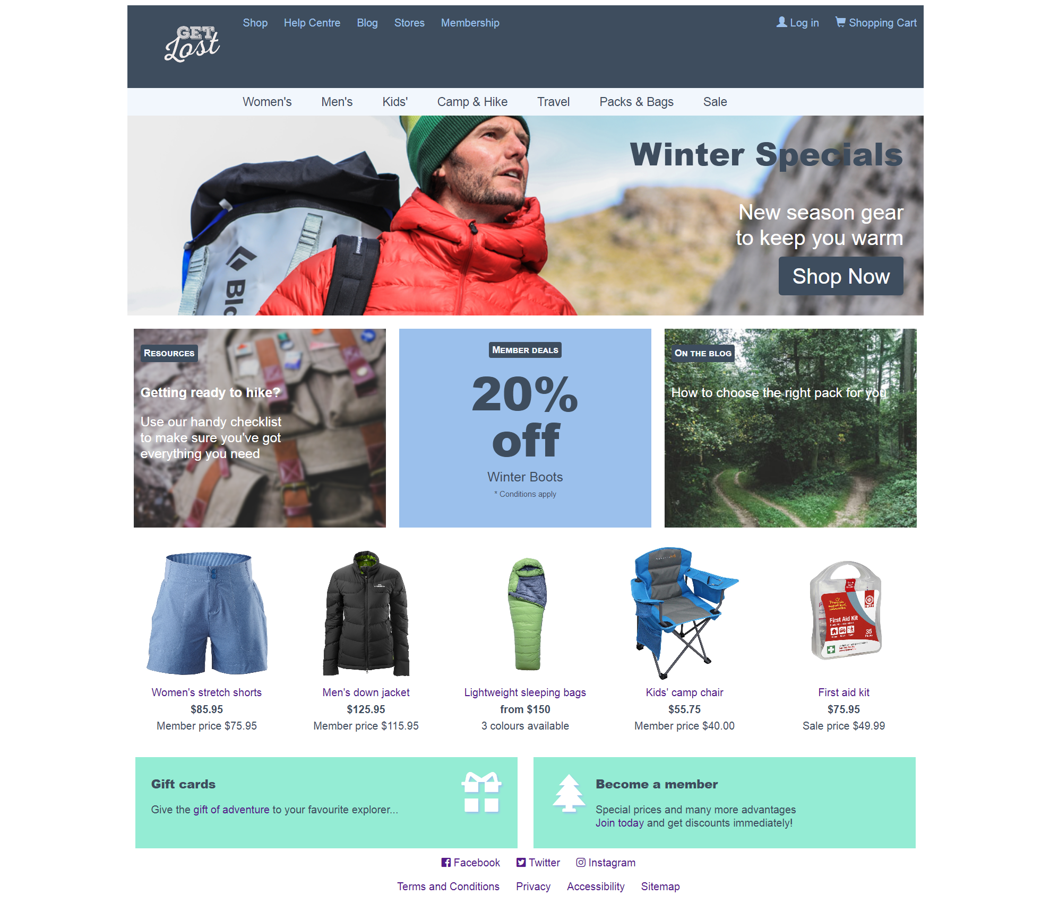
Notes:
Demo page to show the effect of tools and methods
And give examples of the super-easy CSS you can add to any site to support this user group

Slide 4
Notes:
Here I’m using Chrome’s built-in zoom tool to zoom in 300%.

Slide 5
Notes:
This is zoomed to 300%. Notice the scrollbar along the bottom. Zig-zag. Luckily, there’s an easy way to improve this experience for people who zoom.

Slide 6
Notes:
Let’s take a look at my improved version of my demo page

Slide 7
Notes:
Again in Chrome settings, changing to 300%. Using a little technique you might have heard of, called…

Slide 8
Flip to mobile on zoom with em-based responsive design
@media (min-width: 60em) {
header {
display: flex;
text-align: left;
}
nav.nav-store {
text-align: left;
}
nav.nav-store a#store-mobile {
display: none;
}
nav.nav-store ul {
display: block;
}
/* etc */
}
Notes:
Responsive design! Browsers have supported a flip to mobile layout on a zoom for a while now.

Slide 9
Flip to mobile on zoom with em-based responsive design
@media (min-width: 60em) {
header {
display: flex;
text-align: left;
}
nav.nav-store {
text-align: left;
}
nav.nav-store a#store-mobile {
display: none;
}
nav.nav-store ul {
display: block;
}
/* etc */
}
Notes:
Chrome doesn’t need you to use ems for your media queries, they’ll do that nice flip to mobile anyway. But ems has the most cross-browser support at the moment, and it’s not difficult to convert from pixels to ems just for your media queries.

Slide 10
Notes:
The other way people resize your site is using a text-only resize. Fewer people use this method, but the consequences of leaving them unsupported are worse than the horizontal scrollbar for zoomed sites, in my opinion. Let’s take a look at how it affects my site.

Slide 11
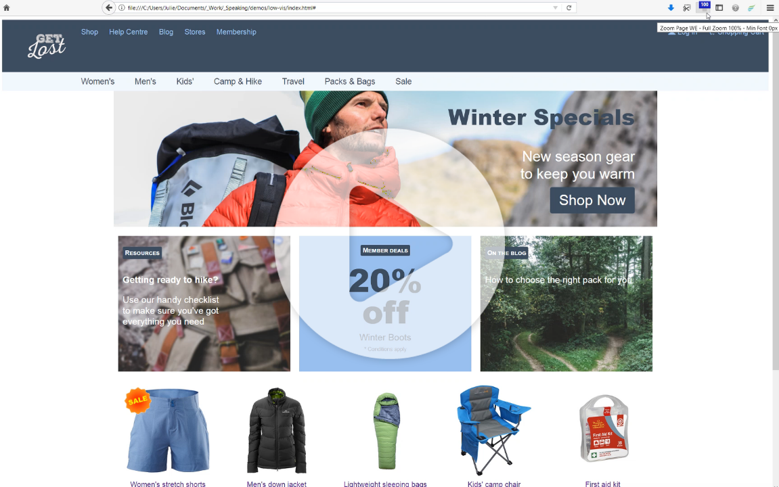
Notes:
Text cut off, background images repeat, there’s a horizontal scrollbar, some text camoflauged.

Slide 12
Allow containers to resize along with text
original.css
improved.css
.feature-stories .block {
background-color: #3e4d5e;
color: #ffffff;
width: 33%;
height: 280px;
}
.feature-stories .block {
background-color: #3e4d5e;
color: #ffffff;
width: 33%;
/* height: 280px;*/
}
Notes:
The easiest fix is just to remove heights. CSS Grid and Flexbox.

Slide 13
Allow containers to resize along with text
original.css
improved.css
.hero {
margin: 0 auto;
background-image: url('coat.png');
}
.hero-block {
width: 40%;
}
.hero {
margin: 0 auto;
background-image: url('coat.png');
background-repeat: no-repeat;
background-color: #3e4d5e;
color: #ffffff;
}
.hero-block {
width: 15em; max-width: 100%;
}
Notes:
More complicated fixes mean making sure you don’t let standalone images repeat, and providing a fallback background colour and a specified text color. You’ll also want to make some of your widths respond to text size via ems or rems instead of percentages or fixed units.
I’m not going to pretend this will give you a pretty site.

Slide 14
Notes:
Resizing one type of element while leaving the others the same will always create unusual proportions.

Slide 15
Notes:
But it’s readable and clear, and that’s all we need to make sure that people who resize text can get on with their shopping.
So that’s resizing. Let’s talk about colour next, which is something people with low vision often have trouble with.

Slide 16
Colour Accessibility Workflows Geri Coady, A Book Apart
Notes:
Most people who work on the front end have heard about color contrast ratios for accessibility. These are really super important for people with low-vision and color blindess. They’re also really useful for situational impairments as well. There’s a wealth of information and tools out there, so if you’re new to the topic, I’ll just recommend this book to get you up to date. Generally, making sure we’ve got enough contrast between our content and our background will make most people happy.

Slide 17
Notes:
But on my original site I’ve got a few areas which make it difficult to get the contrast right, because they’re sitting over a photo. The word ‘specials’ is blending into the rock on the right.

Slide 18
Notes:
If we change the text to white, though, it blends into the sky. There are a few techniques which can make it better. Such as dropshadows on the text itself…

Slide 19
Notes:
Which creates a border effect without having to use a border. Or we can give the text a semi-opaque panel…

Slide 20
Notes:
… so we can still see some of the image behind it, but it’s dark enough for our text. We can make that work with the colours reversed as well.

Slide 21
Notes:
I’m going to use a combination of these techniques on my new and improved website.

Slide 22
Notes:
My fixed version. The other aspect of color for people with low vision is that sometimes we use it as a signal or an indicator for our menus, tabs and form elements, to highlight selected items etc.

Slide 23
Notes:
My main menu uses only colour for a hover and focus effect, and to show which is the current page in the menu. Would pass a contrast check. So how can we test for it?

Slide 24
Check for colour-only indicators with a greyscale filter
body {
filter : grayscale(100%);
}
Notes:
I use a css filter on the body tag. Allows you to test interactive states, forms, etc.

Slide 25
Notes:
When we remove the colour information it’s very hard to tell which is the active item. Many people with low vision or aging vision find it harder to rely on colour at all.

Slide 26
Use changed shapes to distinguish menu items
nav a:link,
nav a:visited {
color: #3e4d5e;
background-color: #f2f7fd;
}
nav a:hover,
nav a:focus {/* reverse colors to create a block effect *;
color: #f2f7fd;
background-color: #3e4d5e;
}
nav a[aria-page=“current”] {
background: url(arrow.png) top center no-repeat;
/* or use a border effect */
}
Notes:
So we need to add something else to the active item style. This is my old reliable method.

Slide 27
Notes:
Here’s my fixed site, and it’s really easy to see the highlighted menu item now, because it’s got a different shape as well as a different colour.

Slide 28
Notes:
It’s not compulsory to do the reverse colors and icon setup, but if you’re in a hurry it’s nice and easy, and I’ve never had a client reject it. Designers should take the opportunity to come up with something better though!

Slide 29
Notes:
Another useful feature of the greyscale filter is that it shows up where links might be difficult to spot for people with low vision.

Slide 30
Notes:
These are a different colour from the text around them, but if colour is a problem for you then they’ll just blend in with the rest of the paragraph.

Slide 31
Colour alone is insufficient to indicate links
Notes:
So just to compare them side by side

Slide 32
Underlines are reliable indicators for most people
Notes:
Underlines do the best job. Can use bold, or italic or borders or background color, but underlines translate the best into different modes.
Some people think that underlines are ugly but we do have an option to give them a little more elegance.

Slide 33
Make underlines prettier with skip-ink
main a { text-decoration: underline; text-decoration-skip-ink: auto;
}
Notes:
At the moment this only works in Chrome, but you can upvote it on the feature lists for Safari and Firefox and IE. And although it’s not strictly speaking a low-vision issue, people with dyslexia find it easier to read than the standard underline links. So you can give support to two groups of people at once.

Slide 34
Notes:
The last type of transformation I want to look at is high contrast. These are operating system themes which provide variations for people with low vision.

Slide 35
Notes:
The high contrast feature in Windows is more extensive and customisable than on a Mac, so if you’re a Mac user, it’s worth your time to test this on a Windows machine just to make sure you’ve got it covered. High contrast views are the most terrifying for designers. Let’s take a look at what my demo site looks like, shall we?

Slide 36
Notes:
Ok, it’s pretty extreme but it’s not all bad. Gap where background image has been removed, and the links are in the user’s chosen color that I find very difficult to see. But the structure of the page is clear, and our icon fonts and SVGs are showing up nicely.

Slide 37
Notes:
But my modal login is pretty difficult to use.

Slide 38
Notes:
Using shadows and background colour to provide shapes for our elements.
Flip back and forth a bit.
Luckily, there is a suuuuper easy technique that gives a huge improvement.

Slide 39
Add borders for high-contrast modes
input,
button,
#modal-container,
.modal-close,
.nav-store a[aria-current=“page”] {
border: 1px solid transparent;
}
Notes:
Borders are respected in high contrast themes, even transparent ones. Anytime you’ve got content overlapping, or relying on text shadows or images to create structure, that’s a good time to think about high contrast.

Slide 40
Notes:
Don’t go overboard with borders – it’s still meant to look like a website, not a spreadsheet.

Slide 41
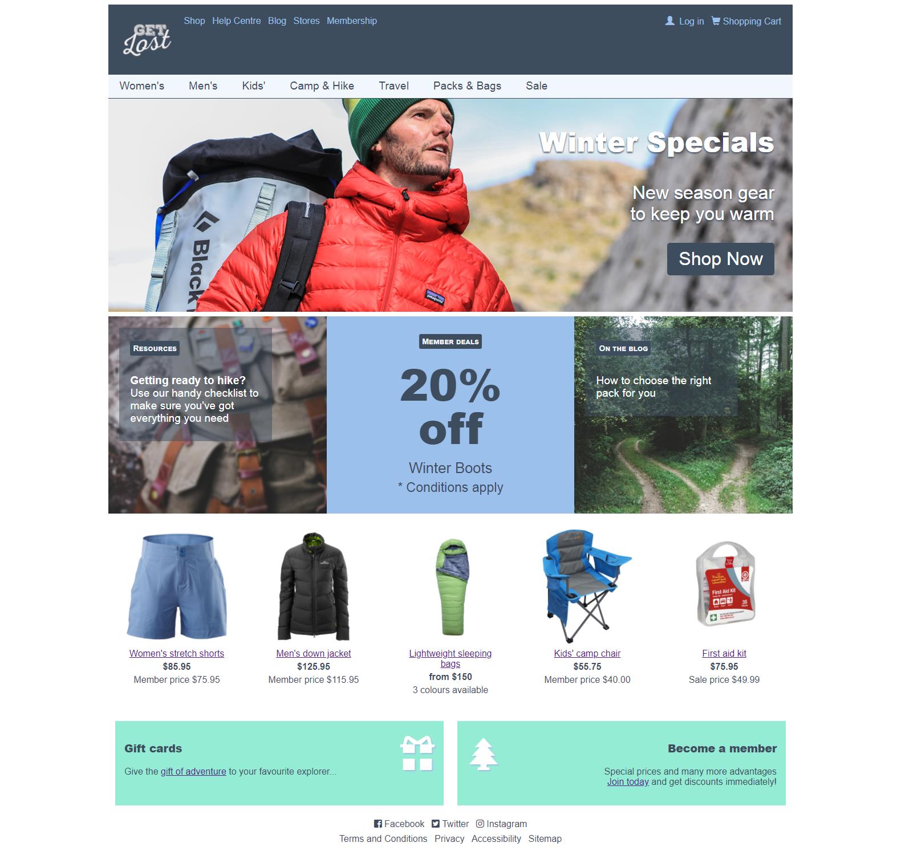
Notes:
So this is my final improved version. You can hardly tell there’s any difference, and at least some of the change I think is my margin and padding values which have nothing to do with supporting low vision users.

Slide 42
Thankyou
Notes and demo: www.juliegrundy.id.au/links/low-vis/notes.html
Julie Grundy @stringy
Notes:
Hope I’ve persuaded you to go back to work and spend an hour or two making these little tweaks to your products, sites, design systems and pattern libraries. 9% gain in audience.

