Slide 1
Building Accessible Components
Julie Grundy @stringy
Notes:
Accessibility is measured on a per page basis, but we usually build one component or chunk at a time.

Slide 2
Notes:
To demonstrate my process, I've built a datepicker component. Newer developers can use my process as a guide to creating their own; more experienced devs might be interested to see what features go into making an accessible datepicker.

Slide 3
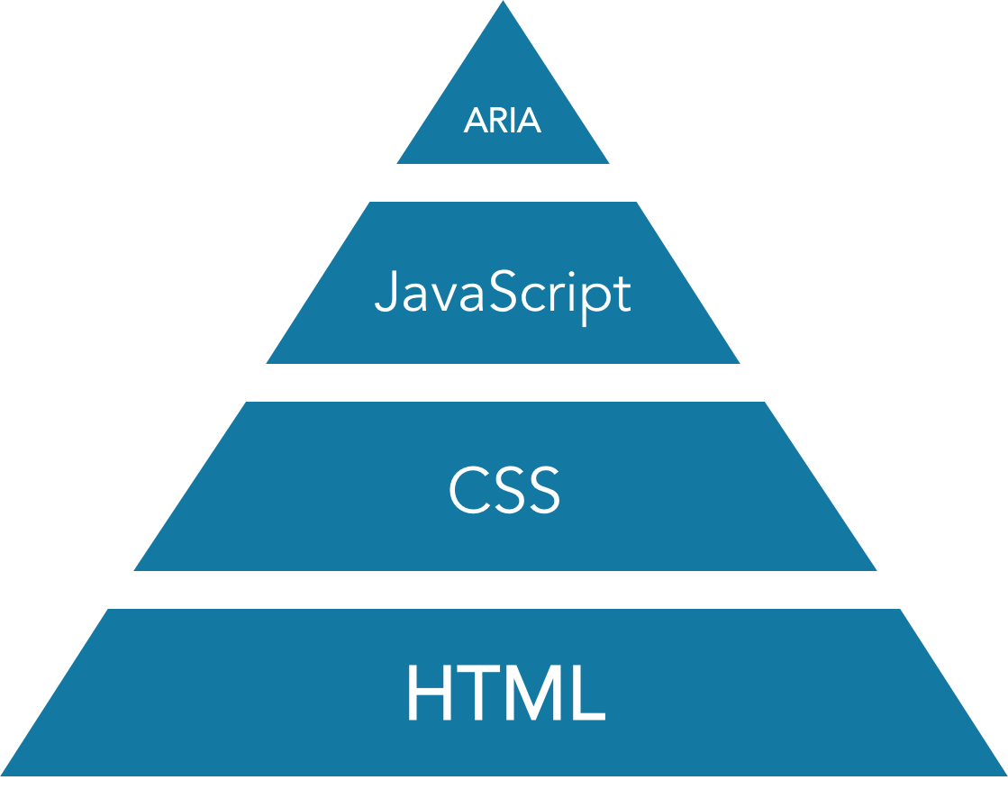
Accessibility Stack
The Accessibility Stack: making a better layer cake Devon Persing
Notes:
My process is based on what my friend Devon Person calls the Accessibility Stack. It's all the technologies we use for accessibility (HTML, JavaScript, CSS and ARIA) sized by how robust they are.

Slide 4
An Accessible Process
Build your base HTML layer
Make it work with JavaScript
Style it with CSS
Enhance with ARIA and goodies
Notes:
If you work on native platforms instead of the web, the technology stack will change but the process will be much the same.

Slide 5
Build your base HTML layer
Step 1

Slide 6
Notes:
This is my original form. It tells you today's date, then asks you to choose one of your own using the text input. I'm using a library called moment.js which make the JavaScript date object easier to work with.

Slide 7
Notes:
When you type in a date and click the Submit button, the form confirms which date you've chosen.

Slide 8
Notes:
And if you don't have a valid date, when you click Submit you get an accessible error message, very similar to what Russ just showed us.

Slide 9
Notes:
I'm going to add a button for my datepicker now. I'm not going to override the text input, because for many people it's easier to type in numbers the way they think of them and let the computer handle the formatting and validation. The work of figuring out what is an okay date format should be our problem, not the user's problem.

Slide 10
Datepicker navigation
<div class="dp-nav"> <h2 id="dp1-heading" tabindex="-1">Available dates in July</h2> <button id="dp1-close">Close</button> <button id="dp1-previous">Previous month</button> <button id="dp1-next">Next month</button> </div>
Notes:
So let's build us a base layer of HTML. This will be the datepicker navigation – a heading with 3 buttons. I'm giving the buttons long names as it's more accessible than just "prev" or "next" or just some arrows with no alt content.

Slide 11
Datepicker navigation
<div class="dp-nav"> <h2 id="dp1-heading" tabindex="-1">Available dates in July</h2> <button id="dp1-close">Close</button> <button id="dp1-previous">Previous month</button> <button id="dp1-next">Next month</button> </div>
Notes:
Notice that I've given the heading a negative tabindex. That's so I can use my JavaScript later on to send focus to the heading.

Slide 12
Add a table for the dates
<div class="dp-body"> <table> <tr> <th scope="col">Sunday</th> <th scope="col">Monday</th> <th scope="col">Tuesday</th> <th scope="col">Wednesday</th> <th scope="col">Thursday</th> <th scope="col">Friday</th> <th scope="col">Saturday</th> </tr> <tr>… rows with dates … </tr> </table> </div>
Notes:
I've chosen to use a table to lay out the dates. You could use a list, but it can only be navigated in a linear way. Screenreader software has shortcuts for users to move around tables more easily.

Slide 13
Add a table for the dates
<div class="dp-body"> <table> <tr> <th scope="col">Sunday</th> <th scope="col">Monday</th> <th scope="col">Tuesday</th> <th scope="col">Wednesday</th> <th scope="col">Thursday</th> <th scope="col">Friday</th> <th scope="col">Saturday</th> </tr> <tr>… rows with dates … </tr> </table> </div>
Notes:
And adding the scope attribute makes it easier for screenreader users to understand which column they're in by associating the header cells to the rest of the cells.

Slide 14
Avoid click handlers on table cells
<td data-handler="selectDay" data-event="click" data-month="9" data-year="2018"> <a class="ui-state-default" href="#">17</a> </td> function() { datepicker._selectDay(id, +this.getAttribute("data-month"), +this.getAttribute("data-year"), this) return false }
Notes:
The problem with tables for layout is that a lot of developers are then tempted to add click events to the cells. You'll see this kind of code in a lot of the big-name datepicker plugins. The problem is that this function only responds to mouse clicks.

Slide 15
Avoid click handlers on table cells
<td data-handler="selectDay" data-event="click" data-month="9" data-year="2018"> <a class="ui-state-default" href="#">17</a> </td> function() { datepicker._selectDay(id, +this.getAttribute("data-month"), +this.getAttribute("data-year"), this) return false } document.addEventListener('keyup', findWhichKey, false)
Notes:
So we have to add some keyboard listeners

Slide 16
Avoid click handlers on table cells
<td data-handler="selectDay" data-event="click" data-month="9" data-year="2018"> <a class="ui-state-default" href="#">17</a> </td> function() { datepicker._selectDay(id, +this.getAttribute("data-month"), +this.getAttribute("data-year"), this) return false } document.addEventListener('keyup', findWhichKey, false) document.addEventListener(‘touchstart’, handleStart, false) document.addEventListener(‘touchend’, handleEnd, false) document.addEventListener(‘touchcancel’, handleCancel, false)
Notes:
And some touch listeners. And there's a Voice API in the early stages so we'll probably have to start adding listeners for listening events soon too.

Slide 17
Input elements support all click types
btnDatepicker.addEventListener('click', function (e) { const whichBtn = e.target submitDate(whichBtn) }
Notes:
It's much easier to use form inputs. All form inputs take focus and click events from any type of input device, so one listener works for all devices.

Slide 18
Notes:
When it comes to form inputs in a datepicker, you could use radio buttons if you only want users to choose a single day

Slide 19
Notes:
Or checkbox inputs if you want them to choose a bunch of days.

Slide 20
Notes:
In my demo I've used buttons because they're more flexible and can be used for more than one type of datepicker.

Slide 21
Make it interactive with JavaScript
Step 2

Slide 22
Hide until JavaScript is available
<button type="button" id="dp1-toggler"> Open date picker </button> <div class="datepicker" id="dp1">… </div>
Notes:
We don't want people trying to use a datepicker unless they've got JavaScript available. So we're going to hide the toggle button in the HTML.

Slide 23
Hide until JavaScript is available
<button type="button" id="dp1-toggle" class="hidden"> Open date picker </button> <div class="datepicker hidden" id="dp1">… </div>
.hidden {display: none;}
Notes:
Using a class with display none on it, so the HTML is removed from the DOM until we ask for it.

Slide 24
Use JavaScript to show the toggler
// on load
btnToggle.classList.remove('hidden')
Notes:
Then when our JavaScript is finished loading, we remove the class. This can be useful for sites which have an offline capability, or if your users are in areas of patchy internet with dropped connections all the time.

Slide 25
Notes:
So now we've got our button and JavaScript available and the user can choose for themselves whether to use the datepicker or not.

Slide 26
Make the toggle control the datepicker
btnToggle.addEventListener('click', function (e) { const body = document.querySelector('body') if (body.classList.contains('has-dialog')) { closeDialog('dp1', e.target) } else { openDialog('dp1', e.target, 'dp1-heading') } })
Notes:
Next we add script to control the opening and closing of the datepicker.

Slide 27
Make the toggle control the datepicker
btnToggle.addEventListener('click', function (e) { const body = document.querySelector('body') if (body.classList.contains('has-dialog')) { closeDialog('dp1', e.target) } else { openDialog('dp1', e.target, 'dp1-heading') } })
Notes:
I'm using the W3Cs example script for a modal window. It's opinionated but manages focus reliably.

Slide 28
Notes:
So here's our datepicker in a modal window. We have a Close button already, so I've added a function for that.

Slide 29
Add Escape key to close the modal
document.addEventListener('keyup', function (e) { e.preventDefault() findWhichKey(e) })
function findWhichKey (pressedKey) { if (pressedKey.key === 'Escape') { closeDialog() } }
Notes:
But we also want to make sure people have an alternative, and the Escape key is the usual method for getting out of somewhere you don't want to be.

Slide 30
Replace the HTML table with script
function createCalendarTable (currentDate) {
const tableLocation = datePicker.querySelector('.dp-body') const tableCalendar = document.createElement('table')
setMonthIndicator(currentDate)
createTableHeaders()
getCurrentDateDetails() createTableCells(weeksInCurrentMonth) addButtonsToCells(daysInCurrentMonth)
addButtonListeners()
}
Notes:
I'm going to replace my static table and buttons with a dynamic version, because I don't want to have to maintain a zillion tables for every possible month someone might need.

Slide 31
Add functions for navigation controls
btnPrevious.addEventListener('click', function () { goToPreviousMonth() setMonthIndicator() datepickerHeading.focus() })
btnNext.addEventListener('click', function () { goToNextMonth() setMonthIndicator() datepickerHeading.focus() })
Notes:
Next I add some controls for the Previous and Next buttons, so people can move forward and backward one month at a time.

Slide 32
Add functions for navigation controls
btnPrevious.addEventListener('click', function () { goToPreviousMonth() setMonthIndicator() datepickerHeading.focus() })
btnNext.addEventListener('click', function () { goToNextMonth() setMonthIndicator() datepickerHeading.focus() })
Notes:
Remember when I put that tabindex on the heading element? It was so I could send focus there when the heading changes so that blind users will be notified that their click was successful.

Slide 33
Disable any out-of-scope dates
btnPrevious.addEventListener('click', function () { goToPreviousMonth() setMonthIndicator() datepickerHeading.focus() disableInvalidControls() })
btnNext.addEventListener('click', function () { goToNextMonth() setMonthIndicator() datepickerHeading.focus() disableInvalidControls() })
Notes:
Now I'm going to disable any dates or months which are out of scope. I don't usually like to disable buttons, but in a datepicker people don't want to suddenly lose a button they've been using, or they might think they've missed a bunch of dates if they've been removed from the table.

Slide 34
Notes:
So here's a month which has the earliest date we can pick.

Slide 35
Create date selection function
btnPickers.addEventListener('click', function (e) {
sendSelectedDate(e.target)
})
function sendSelectedDate (whichOne) {
const whichDay = whichOne.innerHTML const whichDate = currentDate.date(whichDay).format('DD/MM/YYYY') inputDate.value = '' // clear any previous attempts inputDate.value = whichDate closeDialog()
}
Notes:
Finally we get to the real reason we were building a datepicker in the first place – to pick a date. When someone clicks one of our date buttons, we'll send it to the original text input which already has all the validation we need, and we close the modal to return to the form. Are you ready to see my amazing date selection gif? [Next slide autoplays]

Slide 36
Video of HTML
Notes:
Video: The user puts keyboard focus on the input then tabs to the Open Date Picker button. They click the button and the datepicker opens in a modal window. They tab around the dates and buttons, showing the basic focus indicator. They click on a date to select it. The modal closes and the selected date is now in the original text input.

Slide 37
Style it with CSS
Step 3

Slide 38
Notes:
I read out my CSS to you, I'll just point out the changes I made for accessibility reasons.

Slide 39
Feature: close button
Notes:
The Close button now has an accessible SVG icon in the HTML with alt text available.

Slide 40
Feature: Previous month
Notes:
Any navigation buttons which have been disabled have a style distinct from the enabled buttons.

Slide 41
Feature: selected date
Notes:
The currently selected date has it's own style

Slide 42
Feature: focus indicator
Notes:
And so does the currently hovered or focused date. Let's just confirm this works with some of the tools people with low vision might be using.

Slide 43
Notes:
This is our modal when the whole page has been zoomed in

Slide 44
Notes:
This is how it looks when text has been resized.

Slide 45
Notes:
And this is how it looks in a high contrast theme. I think it could do with some more emphasis on the selected date and hover effect, but that's a job for the next release. Overall I'm pretty happy with how it looks, it's accessible and I wouldn't be embarrassed to show it to a designer.

Slide 46
Enhance with ARIA and animation
Step 4

Slide 47
Replace 'selected' class with ARIA
whichBtn.classList.add('selected')
<button type="button" class="selected">20</button>
button.selected { background: #311b92; color: #CDC7E5; border-color: #311b92; }
Notes:
My CSS for the selected date works well for most people with low vision, but it isn't reflected in the HTML so people using screenreaders won't know about it.

Slide 48
Replace 'selected' class with ARIA
whichBtn.setAttribute('aria-current', 'selected')
<button type="button" aria-current="selected">20</button>
button.selected, button[aria-current] { background: #311b92; color: #CDC7E5; border-color: #311b92; }
Notes:
You can use ARIA attributes as CSS selectors though, so I've switched them over here. This way we've got our programmatic and our visual markers tied together.

Slide 49
ARIA live for month notification
<h2 id="dp1-heading" tabindex="-1"> Available dates in <span id="dp1-currentmonth">July</span> </h2>
btnPrevious.addEventListener('click', function () { goToPreviousMonth() setMonthIndicator() datepickerHeading.focus() })
Notes:
Another little improvement for usability is to replace the focus method as the way of letting screenreader users know when they've successfully changed months.

Slide 50
ARIA live for month notification
<h2 id="dp1-heading"> Available dates in <span id="dp1-currentmonth" aria-live="polite">July</span> </h2>
btnPrevious.addEventListener('click', function () { goToPreviousMonth() setMonthIndicator() // datepickerHeading.focus() })
Notes:
I'm not sure if Russ covered this in his workshop yesterday, but I've just marked that little bit of heading as an aria live region. It will be announced each time the text is updated, and now I can remove that focus shift and reduce the amount of keyboard navigation people have to do.

Slide 51
A cycle
JavaScript
CSS
ARIA
HTML
Notes:
You've probably noticed that I haven't stuck just to one of the accessibility technologies at a time. Each one interacts with and is supported by the others. So you might see my 4 steps as more of an iterative process than a step-by-step formula. Regardless of technology, I do find myself following those steps over and over again, so maybe it's better to just re-phrase them in a technology-agnostic way.

Slide 52
Final process
Build a semantic base
Make it interactive
Style it
Enhance it
Notes:
When you break it down, this is essentially a progressive enhancement process. A lot of my thinking on this topic has been influenced by Jeremy Keith.

Slide 53
Watch this
Enhance! at An Event Apart (Vimeo) Jeremy Keith
Notes:
If you have time, I recommend his talk called "Enhance!" from An Event Apart, a few years ago. Sadly, it doesn't have any captions that I could find. If you think about it, accessibility ensures that our work translates not just to different browsers but also to different input and output devices.

Slide 54
Resources
www.juliegrundy.id.au/links/components.html
Thankyou!
Notes:
And by making sure our base layers are solid and accessible, we can spend more time working on the goodies. I hope this has been useful for you. I've put the slides and code online, so if you want to have a go at building on top of this demo, please do feel free to see what you can do to improve it.

